Slide 1
Pathfinder Player Tool
Models, Data Dictionary, and Analysis
Slide 1

Slide 2
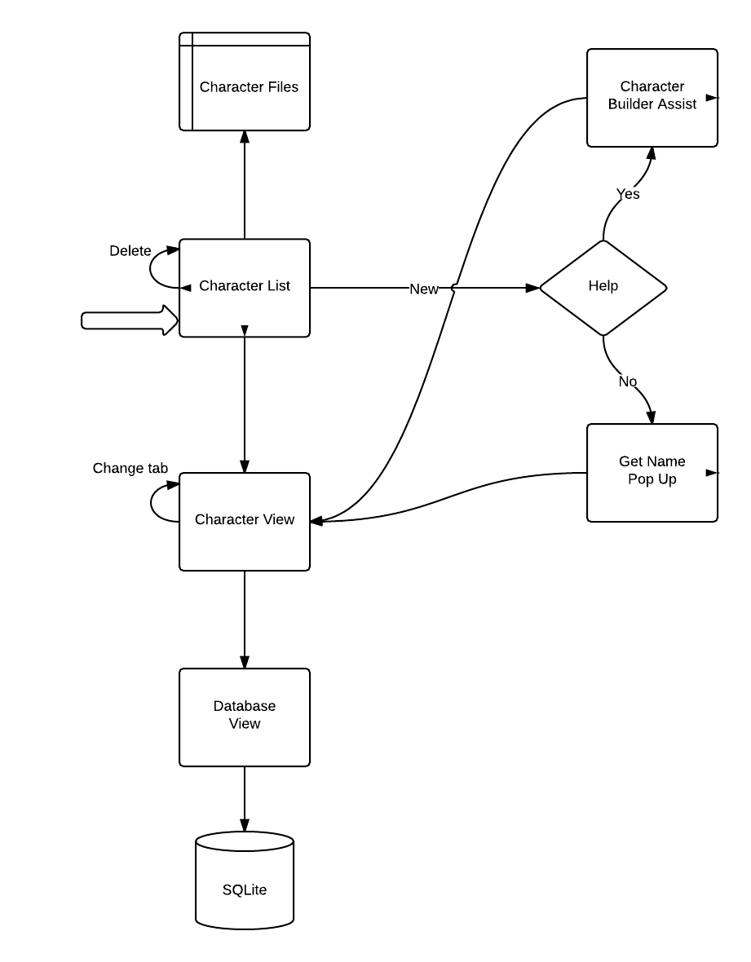
Model
Slide 2

Slide 3
Data Dictionary
Character: Encapsulates all information about the character. Contains name, race, description, and other details.
Spell: Contains the name of the spell and a description of what it does along with other valuable information such as spell level.
Feat: Contains the description of the feat and the requirements to acquire.
Armor/Weapon: Contains the name of the item along with damage and armor class.
Etc…
Slide 3

Slide 4
File vs Database
File provides easy access
Object can be serialized
Database provides more structure
Database provides indexing
Slide 4

Slide 5
Slide 1

